Slide 1

Healthcare Analytics for Doctor Visits TIRTC
Ann Mary Rifna M J
AICET ID: STU6a69c27e0bba61785315966
Mar Athanasius College of Engineering

Slide 2

PROBLEM STATEMENT
The problem is to analyze patient healthcare data to identify patterns, relationships, and factors associated with doctor visits, and derive meaningful insights that can support better healthcare planning and decision-making.

Slide 3
Project Description
This project focuses on analyzing healthcare data to understand doctor visit patterns among patients. The analysis examines demographic factors such as age, gender, and income, along with illness, health status, reduced activity, healthcare coverage, and chronic conditions.
Using data cleaning, exploratory data analysis, statistical analysis, and visualizations, the project aims to identify meaningful patterns and relationships that can help understand healthcare utilization.

Slide 4

WHO ARE THE END USERS?
Healthcare providers & doctors – to understand patient visit patterns and healthcare needs.
Hospitals & clinics – to support resource and service planning.
Healthcare administrators – to analyze healthcare utilization and patient trends.
Public health organizations – to identify population-level healthcare patterns
Data analysts & researchers – to study factors influencing healthcare utilization.

Slide 5

Technology Used
  Python
  Pandas
  NumPy
  Matplotlib
  seaborn

Slide 6
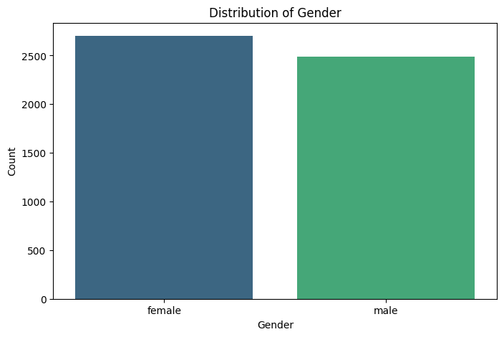
RESULTS
Female patients are slightly higher in number than male patient

Slide 7
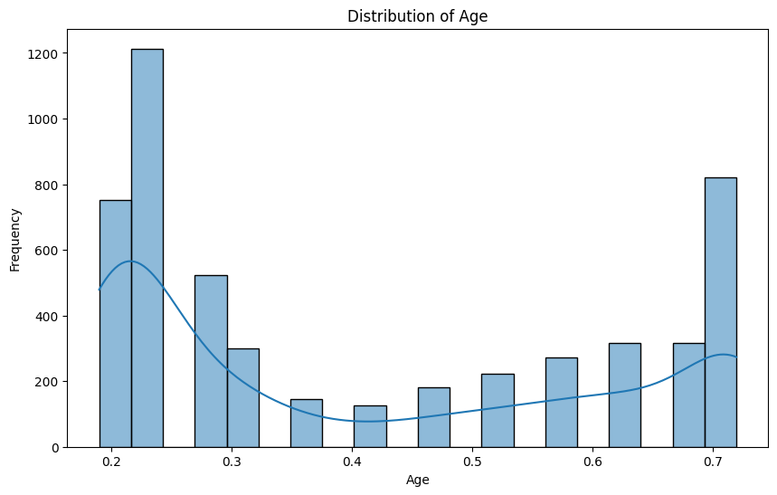
RESULTS
Younger patients are more represented in the dataset, with age around 0.2–0.3 having the highest frequency.

Slide 8
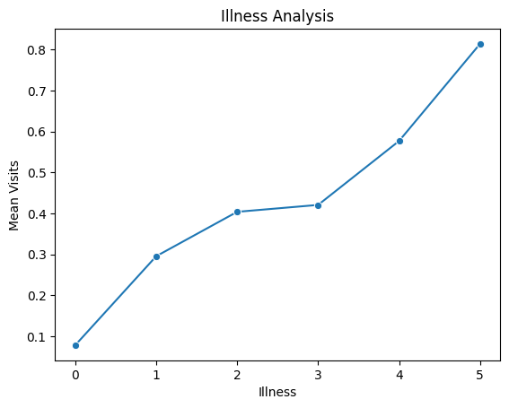
RESULTS
Doctor visits increase as the number of reported illnesses increases, with patients having 5 illnesses showing the highest average visits.

Slide 9
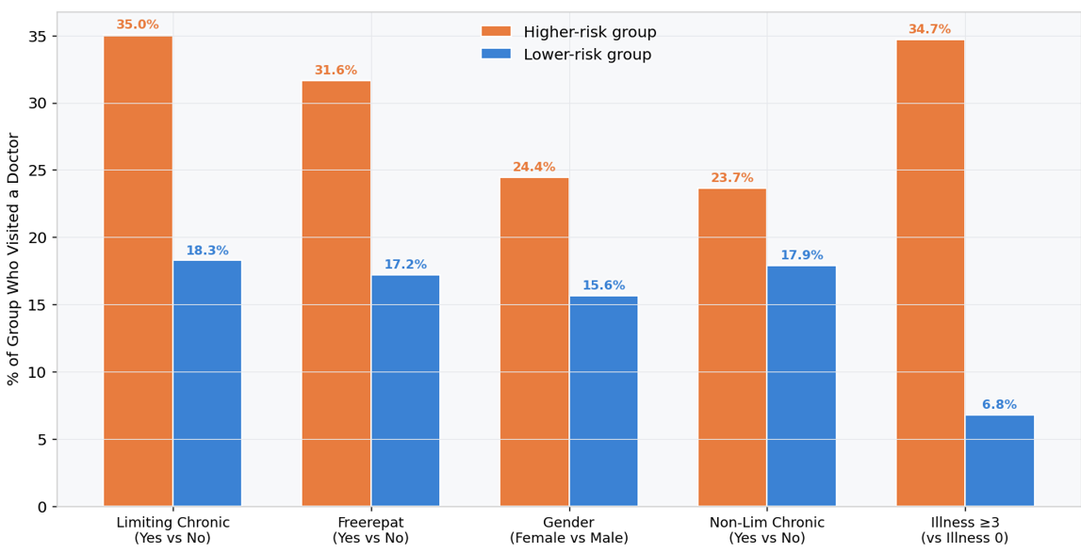
RESULTS
Higher-risk patients show a higher proportion of doctor visits across all analyzed health-related factors.

Slide 10
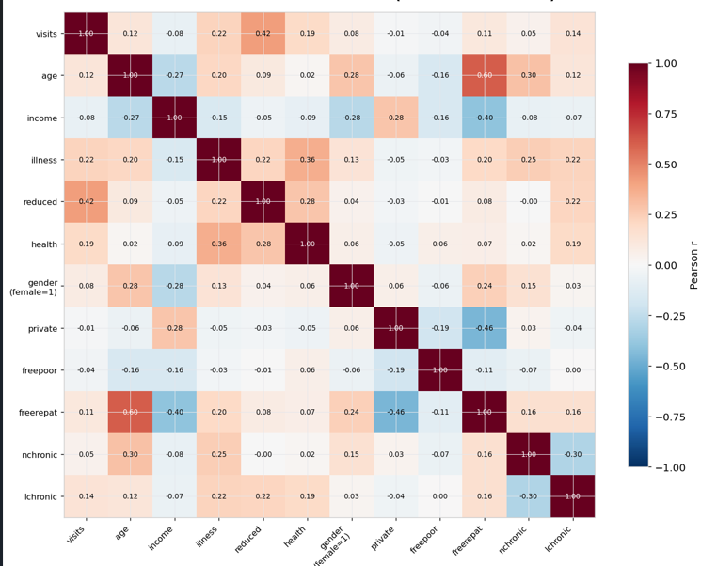
RESULTS
Doctor visits have the strongest positive relationship with reduced activity, followed by illness and poor health status.

Slide 11
GitHub Link
https://github.com/annmaryrifna/Data-Analysis/upload/main/
Healthcare%20Analytics%20for%20Doctor%20Visits

Slide 12
Thank you
.
.

